Slide 1
Unit – 6
Field Effect Transistor (FET) And MOSFET

Slide 2
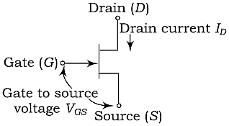
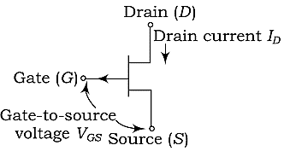
CONSTRUCTION OF JFET
Figure 1: Symbol of n-channel FET
Figure 2: Symbol of p-channel FET

Slide 3
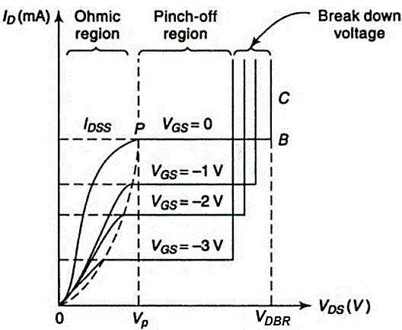
PRINCIPLE OF JFET (n-Channel)
Drain characteristics of JFET

Slide 4
PRINCIPLE OF JFET (n-Channel)
When $V_{GS}=0$ and $V_{DS}=0$
When $V_{DS}=0$ and $V_{GS}$ is decreased from zero
When $V_{GS}=0$ and $V_{DS}$ is increased from zero
When $V_{GS}$ is negative and $V_{DS}$ is increased
Drain characteristics of JFET

Slide 5
CHARACTERISTICS PARAMETERS OF JFET
1. Mutual conductance or transconductance, $g_{m}$
$$g_{m}={\left(\frac{∂I_{D}}{∂V_{GS}}\right)}_{V_{DS}}=\frac{ΔI_{D}}{ΔV_{GS}}, with V_{DS} constant$$
2. Drain resistance, $r_{d}$
$$r_{d}={\left(\frac{∂V_{DS}}{∂I_{D}}\right)}_{V_{GS}}=\frac{ΔV_{DS}}{ΔI_{D}}, with V_{GS} constant$$
3. Drain conductance, $g_{d}$
$$g_{d}={\left(\frac{∂I_{D}}{∂V_{DS}}\right)}_{V_{GS}}=\frac{ΔI_{D}}{ΔV_{DS}}, with V_{GS} constant$$
4. Amplification factor, $μ$
$$μ=−{\left(\frac{∂V_{DS}}{∂V_{GS}}\right)}_{I_{D}}=−\frac{ΔV_{DS}}{ΔV_{GS}}, with I_{D} constant$$

Slide 6
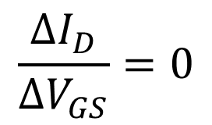
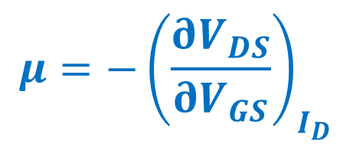
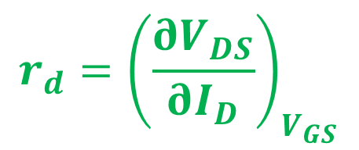
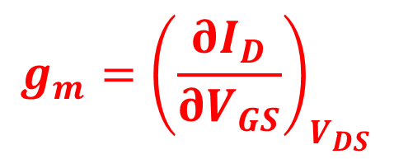
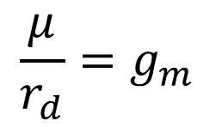
Relationship among FET parameters or Relation between $μ, r_{d} \& g_{m}$
$$I_{D}=f\left(V_{DS},V_{GS}\right)$$
Using Taylor’s theorem by considering fractional change in $V_{DS}, V_{GS} \& I_{D}$
$$ΔI_{D}={\left(\frac{∂I_{D}}{∂V_{DS}}\right)}_{V_{GS}}ΔV_{DS}+{\left(\frac{∂I_{D}}{∂V_{GS}}\right)}_{V_{DS}}ΔV_{GS}$$
$$g_{m}={\left(\frac{∂I_{D}}{∂V_{GS}}\right)}_{V_{DS}}$$
$$\frac{μ}{r_{d}}=g_{m}$$
$$\boxed{μ=r_{d}×g_{m}}$$
$$\frac{ΔI_{D}}{ΔV_{GS}}={\left(\frac{∂I_{D}}{∂V_{DS}}\right)}_{V_{GS}}\left(\frac{ΔV_{DS}}{ΔV_{GS}}\right) +{\left(\frac{∂I_{D}}{∂V_{GS}}\right)}_{V_{DS}}$$
$$r_{d}={\left(\frac{∂V_{DS}}{∂I_{D}}\right)}_{V_{GS}}$$
$$\frac{ΔI_{D}}{ΔV_{GS}}=0$$
$$μ=−{\left(\frac{∂V_{DS}}{∂V_{GS}}\right)}_{I_{D}}$$
If $I_{D}$ is constant,
$$0={\left(\frac{∂I_{D}}{∂V_{DS}}\right)}_{V_{GS}}\left(\frac{ΔV_{DS}}{ΔV_{GS}}\right) +{\left(\frac{∂I_{D}}{∂V_{GS}}\right)}_{V_{DS}}$$
$$0=\left(\frac{1}{r_{d}}\right)\left(−μ\right)+g_{m}$$

Slide 7
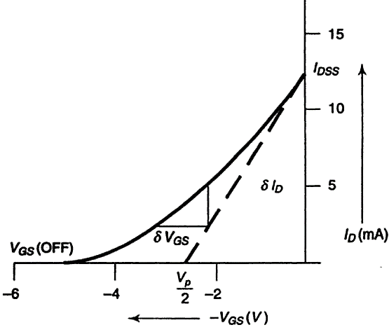
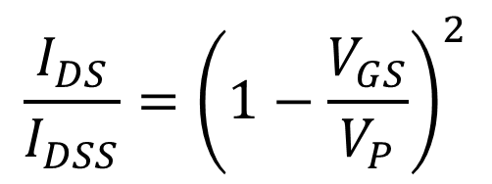
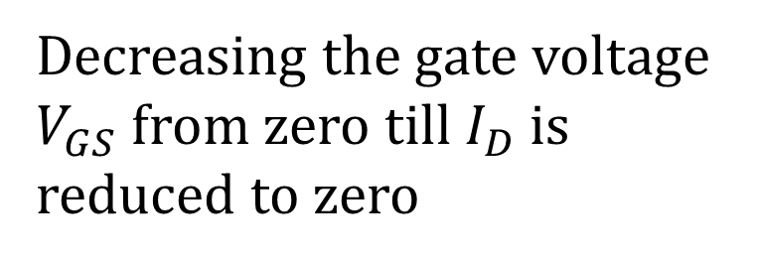
$$g_{m}=\frac{2}{\left|V_{P}\right|}\sqrt{I_{DS}×I_{DSS}}$$
Shockley gives the equation of drain characteristics as:
Show that
$$\frac{I_{DS}}{I_{DSS}}={\left(1−\frac{V_{GS}}{V_{P}}\right)}^{2}$$
Characteristic is parabolic
This resembles equation of parabola
Decreasing the gate voltage $V_{GS}$ from zero till $I_{D}$ is reduced to zero
Equation of Parabola is given as
$$y=x^{2}$$
$$I_{DS}=I_{DSS}{\left(1−\frac{V_{GS}}{V_{P}}\right)}^{2}$$

Slide 8
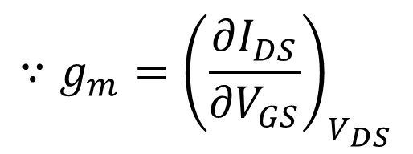
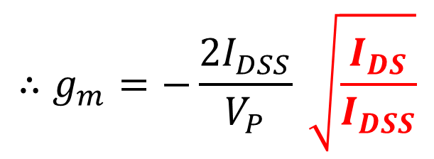
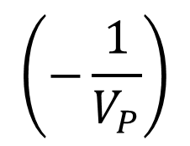
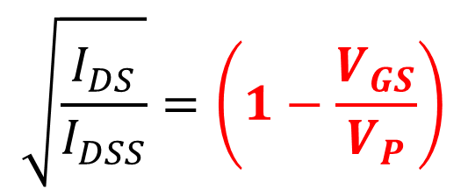
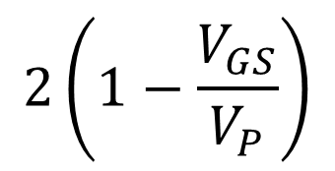
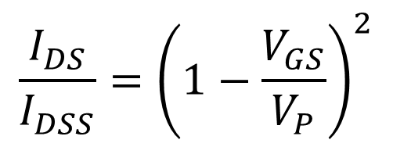
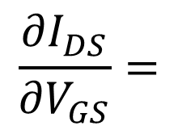
$$I_{DS}=I_{DSS}{\left(1−\frac{V_{GS}}{V_{P}}\right)}^{2}$$
$$\frac{I_{DS}}{I_{DSS}}={\left(1−\frac{V_{GS}}{V_{P}}\right)}^{2}$$
Differentiating above equation with respect to $V_{GS}$,
$$\sqrt{\frac{I_{DS}}{I_{DSS}}}=\left(1−\frac{V_{GS}}{V_{P}}\right)$$
$$\frac{∂I_{DS}}{∂V_{GS}}=$$
$$2\left(1−\frac{V_{GS}}{V_{P}}\right)$$
$$\left(−\frac{1}{V_{P}}\right)$$
$$I_{DSS}×$$
$$∴g_{m}=−\frac{2I_{DSS}}{V_{P}} \sqrt{\frac{I_{DS}}{I_{DSS}}}$$
$$=−\frac{2I_{DSS}}{V_{P}} \left(1−\frac{V_{GS}}{V_{P}}\right)$$
$$∴g_{m}=\frac{2}{{−V}_{P}} \sqrt{\frac{I_{DSS}^{2}×I_{DS}}{I_{DSS}}}$$
$$∵g_{m}={\left(\frac{∂I_{DS}}{∂V_{GS}}\right)}_{V_{DS}}$$
$$=\frac{2}{{−V}_{P}}\sqrt{I_{DSS}×I_{DS}}$$
$$g_{m}=−\frac{2I_{DSS}}{V_{P}} \left(1−\frac{V_{GS}}{V_{P}}\right)$$
$$g_{m}=\frac{2}{\left|V_{P}\right|}\sqrt{I_{DS}×I_{DSS}}$$

Slide 9
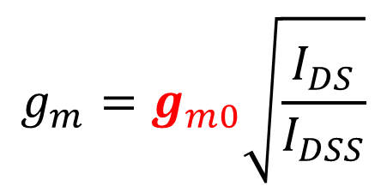
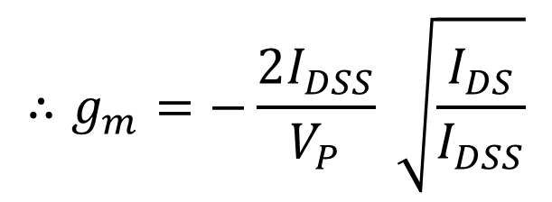
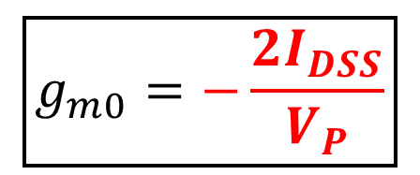
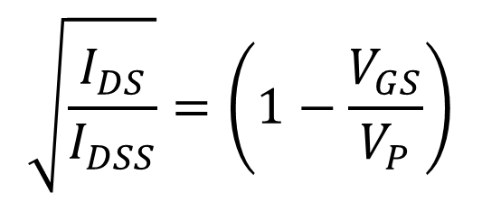
$$g_{m}=−\frac{2I_{DSS}}{V_{P}} \left(1−\frac{V_{GS}}{V_{P}}\right)$$
$$\frac{I_{DS}}{I_{DSS}}={\left(1−\frac{V_{GS}}{V_{P}}\right)}^{2}$$
Let $g_{m}=g_{m0}$ when $V_{GS}=0$
$$\sqrt{\frac{I_{DS}}{I_{DSS}}}=\left(1−\frac{V_{GS}}{V_{P}}\right)$$
$$g_{m0}=−\frac{2I_{DSS}}{V_{P}}\left(1−\frac{0}{V_{P}}\right)$$
$$∴g_{m}=−\frac{2I_{DSS}}{V_{P}} \sqrt{\frac{I_{DS}}{I_{DSS}}}$$
$$\boxed{g_{m0}=−\frac{2I_{DSS}}{V_{P}}}$$
$$∴g_{m}=\frac{2}{{−V}_{P}} \sqrt{\frac{I_{DSS}^{2}×I_{DS}}{I_{DSS}}}$$
$$g_{m}=g_{m0} \left(1−\frac{V_{GS}}{V_{P}}\right)$$
$$=\frac{2}{{−V}_{P}}\sqrt{I_{DSS}×I_{DS}}$$
$$g_{m}=g_{m0}\sqrt{\frac{I_{DS}}{I_{DSS}}}$$
$$g_{m}=\frac{2}{\left|V_{P}\right|}\sqrt{I_{DS}×I_{DSS}}$$

